Slide 1
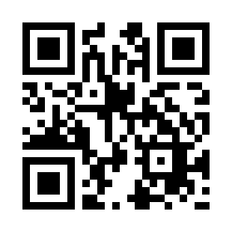

Software Team Management Quiz 01
https://bit.ly/3Qg2Q4v

